Slide 1

FOOTBALL DATA ANALYSIS
Submitted By:
Yashvardhan Uniyal (200050131133)
Sahaj Jayswal (200050131167)

Slide 2
About the project
In this project we did a detailed analysis of the dataset of English Premier League 2021-22. Firstly, we had to clean the data and rename some columns having similar names. Following this we identified the total number of null rows in the data. Then, using various data analysis techniques and commands we obtained different visualization and interesting patterns driven from data itself.

Slide 3
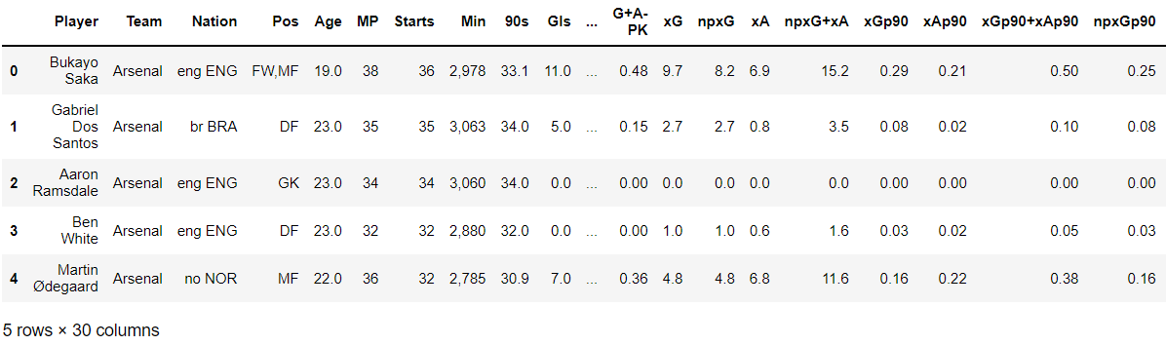
DATASET
The dataset contains stats of all the players of all 20 teams that contested in 2021-22 season of English premier league.

Slide 4
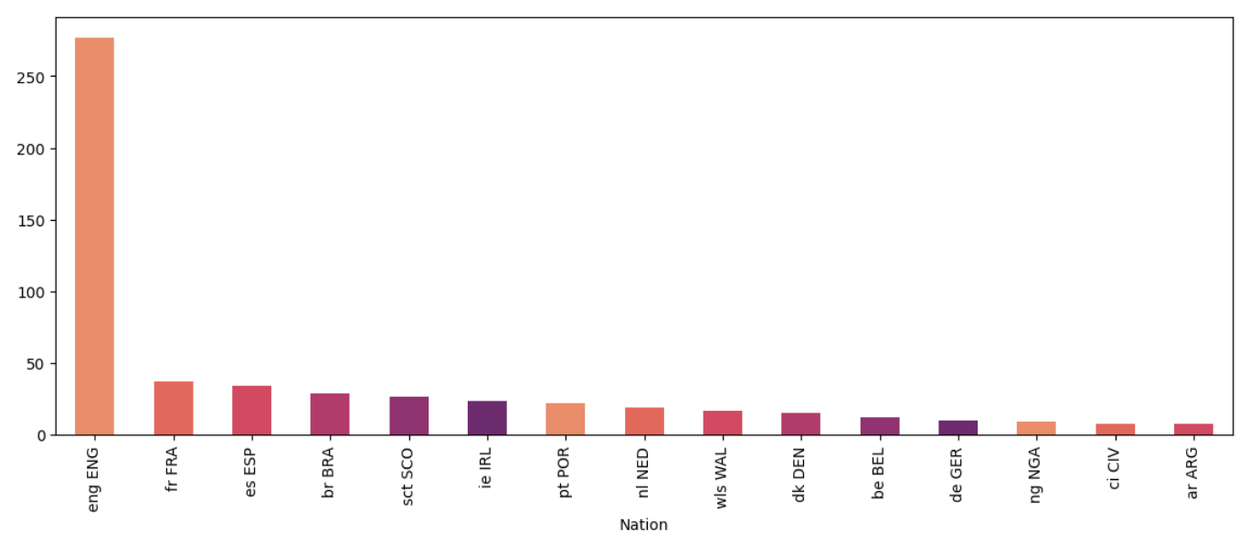
RESULTS OBTAINED FROM THE DATA
Countrywise representation in EPL
Conclusion: England has the highest number of players playing for different teams in the EPL followed by France, Spain, Brazil, Scotland which complete the top 5.

Slide 5
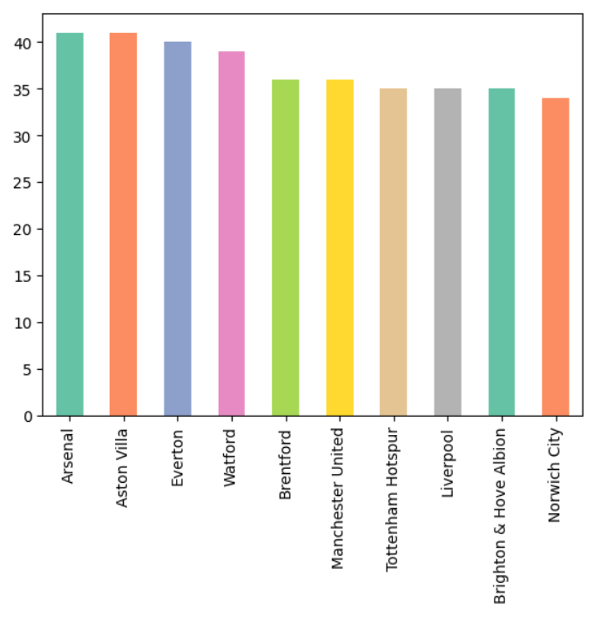
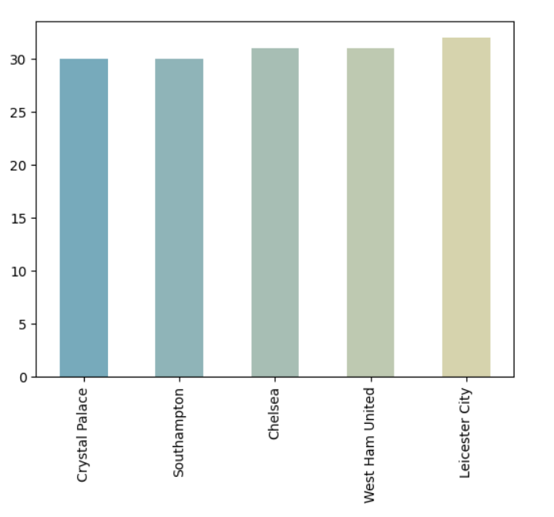
Teams with most number of players in the squad
Conclusion : Arsenal and Aston villa have the biggest squads in the EPL. Whereas, Crystal palace and Southampton have the smallest squads.

Slide 6
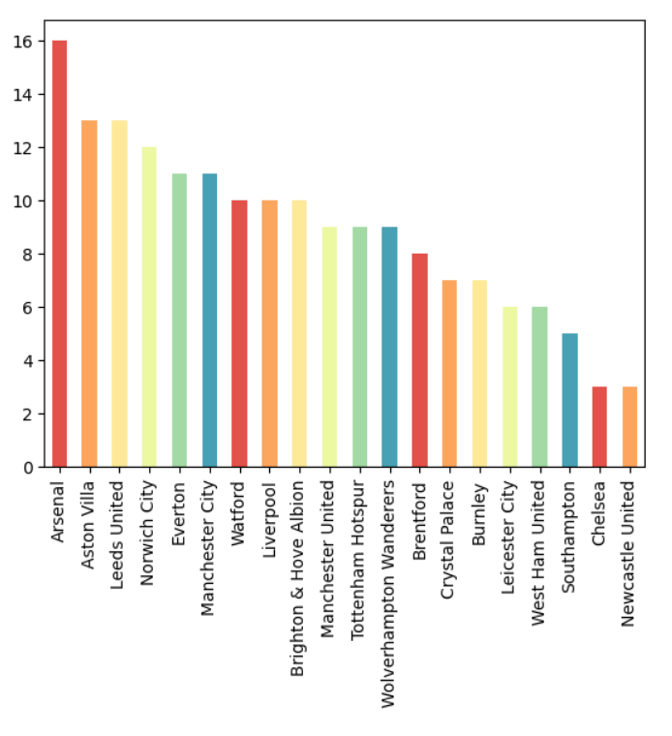
Under-20 players in each team
Conclusion: Arsenal has most players aged 20 or less in the team followed by Aston villa and Leeds united. Newcastle & Chelsea having the joint least U-20 players.

Slide 7
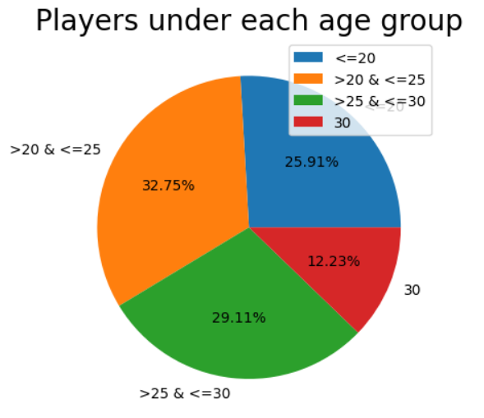
Players under each age group
Conclusion: Most of the players who currently play in the EPL are aged between 20-25. More than 60% of players are 20-30 years old.

Slide 8
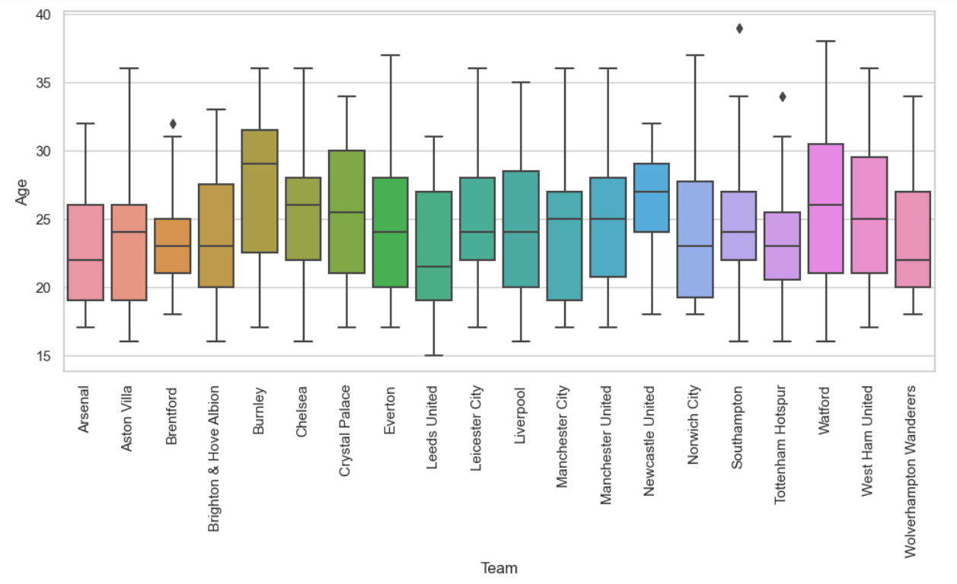
Average age of players of each team
Conclusion: Newcastle United have the highest average age of players present in the team

Slide 9
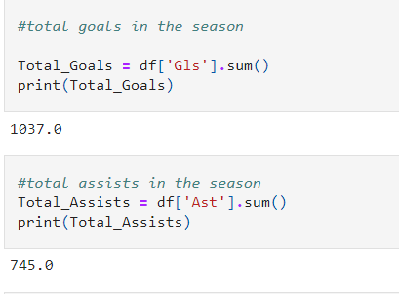
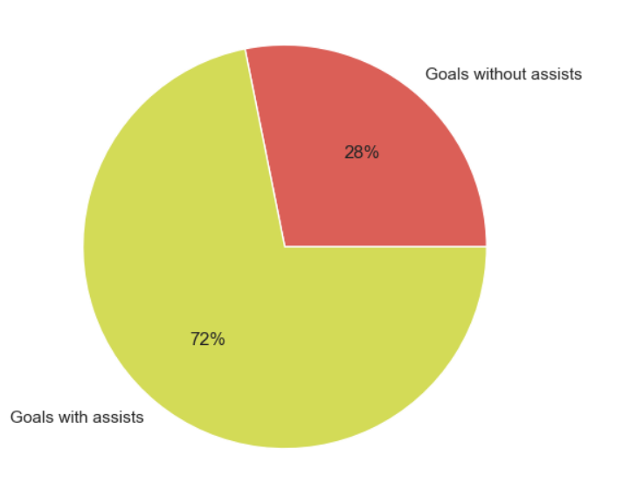
Total Goals scored in the season : 1037
Total Assists in the season : 745
Goals with and without assists

Slide 10
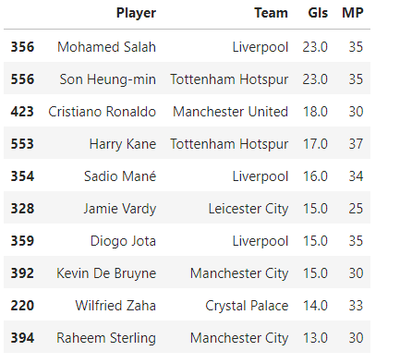
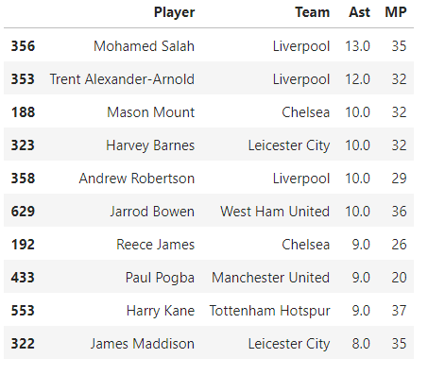
Top Goalscorers
Conclusion: Mohammed Salah of Liverpool FC and Son Heung-min of Tottenham hotspurs were joint top scorers in the EPL 2021-22 season.
Top Playmakers
Conclusion: Mohamed Salah provided the highest number of assists in the season. Hence we can say that Salah was the best player in EPL 2021-22.

Slide 11
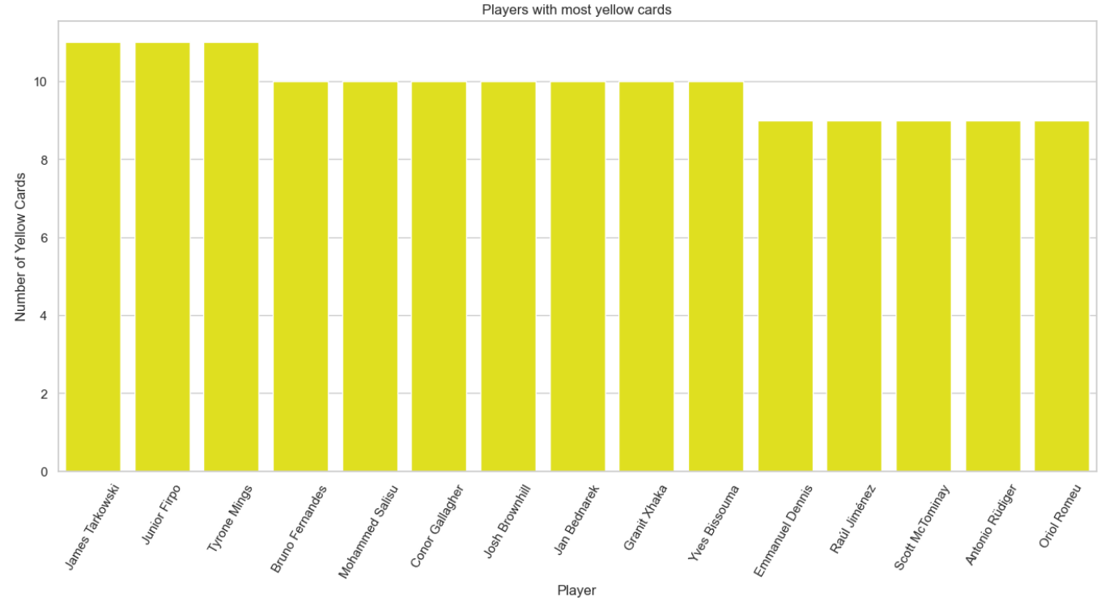
Players with most yellow cards
Conclusion: James Tarkowski, Junior Firpo, Tyrone Mings got the highest number of yellow cards(11) over the season.

Slide 12
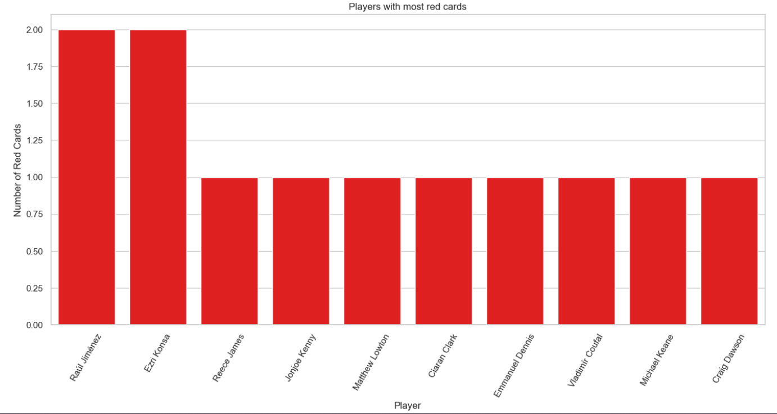
Players with the most red cards
Conclusion: Raul Jimenez and Ezri Konsa received 2 red cards each. Hence both of them can be labelled as the most indisciplined players of the season.

